Slide 1
HISD Connect Online Enrollment Process
Federal and State Compliance
Wanda Thomas, Sr. Manager
Marina Tejada
Sr Student Information Representative
Date: January 22, 2021

Slide 2
Agenda
Participants will receive step by step online instructions
Printing Portal Letters

Slide 3
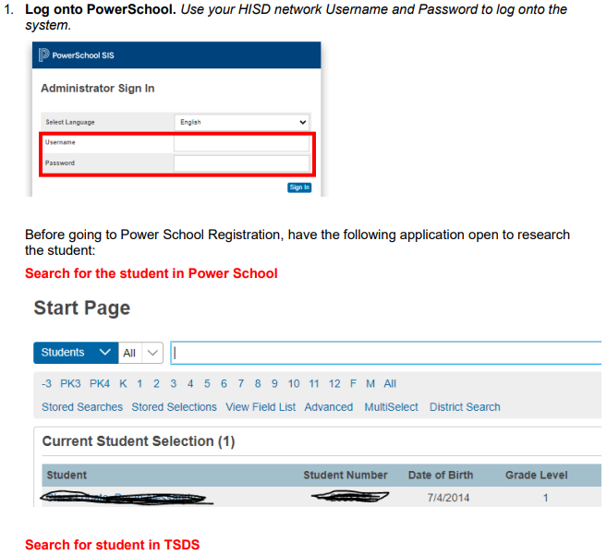
This document outlines the technical and manual process for the HISD Connect Enrollment application.

Slide 4
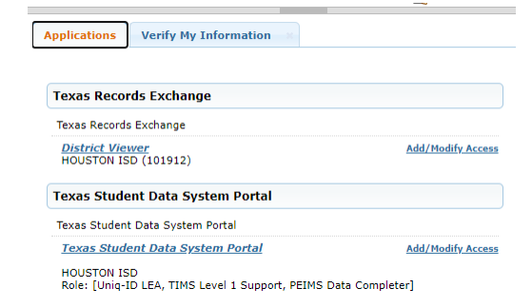
TSDS Search

Slide 5
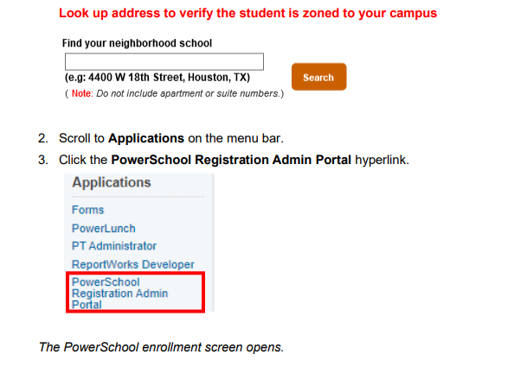
Address Verification and PowerSchool Registration Admin Portal

Slide 6
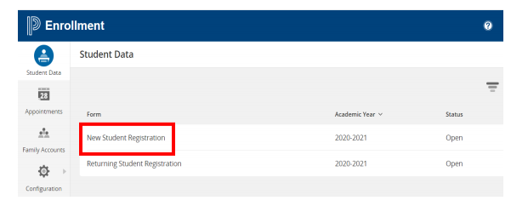
HISD Connect Enrollment Page

Slide 7
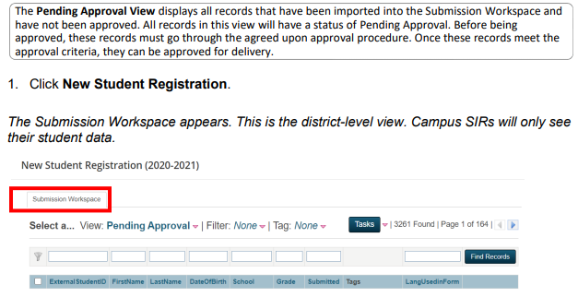
Pending Approval

Slide 8
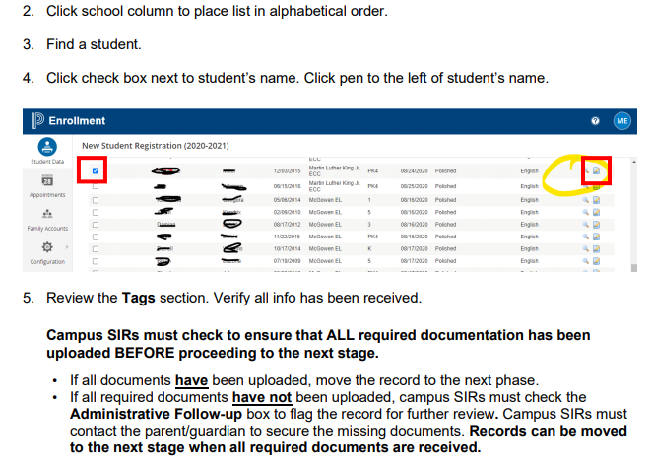
Pending Approval Continued

Slide 9
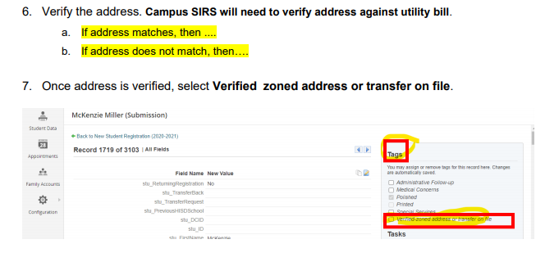
Address Verification

Slide 10
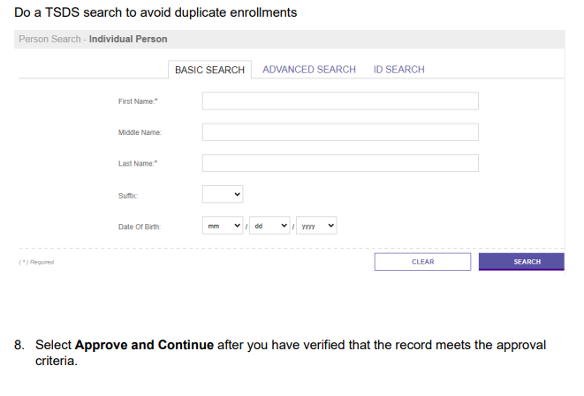
TSDS Verification and Approval

Slide 11
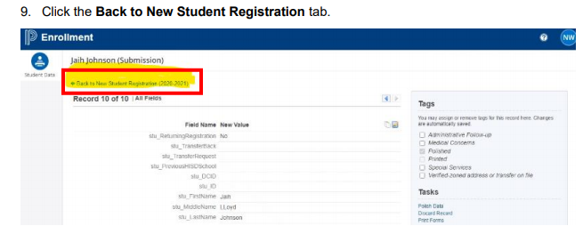
Back to New Student Registration

Slide 12
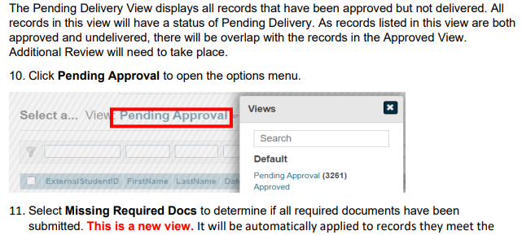
Pending Delivery

Slide 13
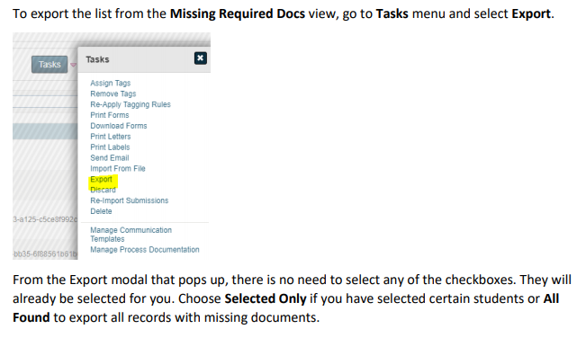
To match the current process of approving enrollments, regardless of whether they have all approved documents, records will come into this view regardless of their position (Pending Approval, Approved, Delivered) in the workflow.

Slide 14
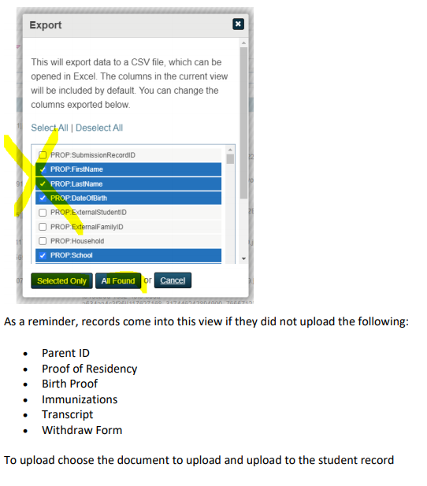
Exporting Data

Slide 15
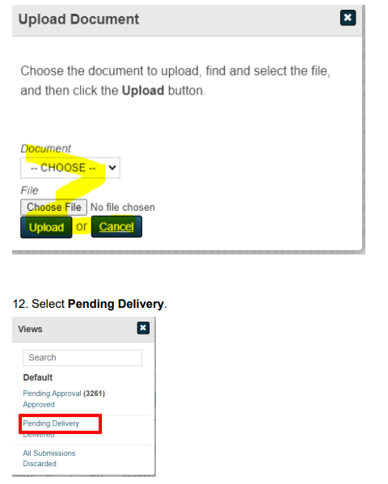
Upload Cont. & Step 12

Slide 16
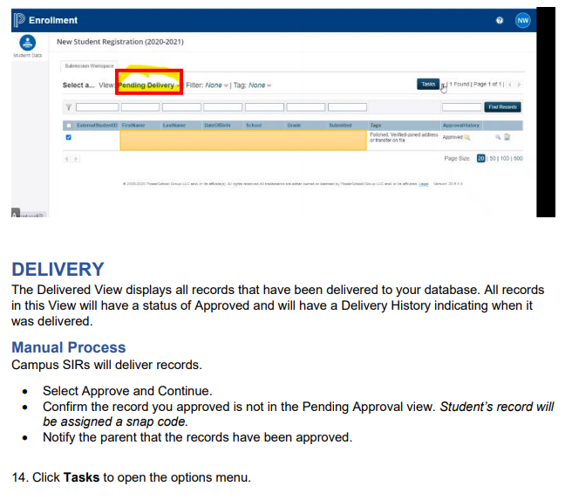
Delivery Steps 13-14

Slide 17
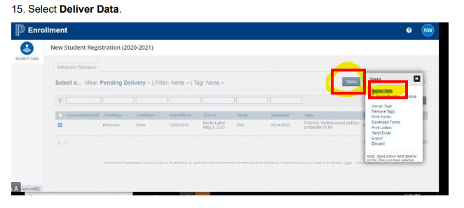
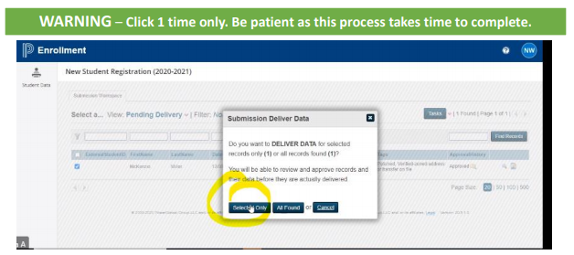
Delivery Steps 15 &16

Slide 18
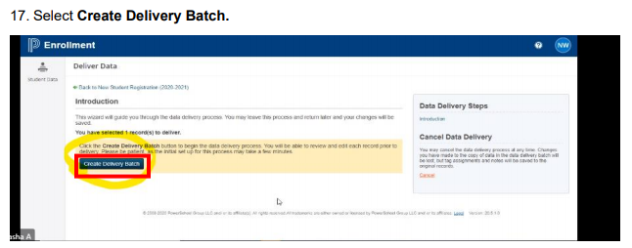
Delivery Steps 17 & 18

Slide 19
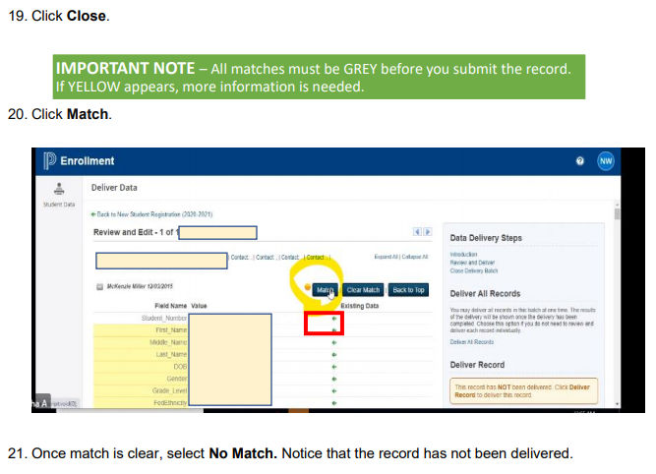
Delivery Steps 19-21

Slide 20
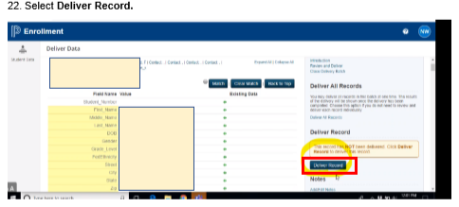
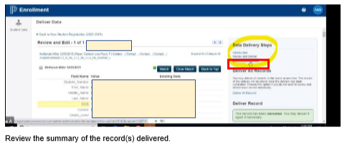
Delivery Steps 22 & 23

Slide 21
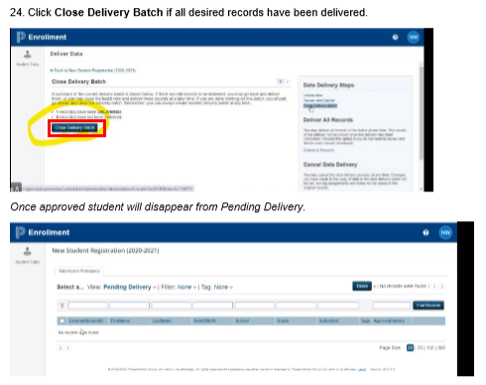
Delivery Step 24

Slide 22
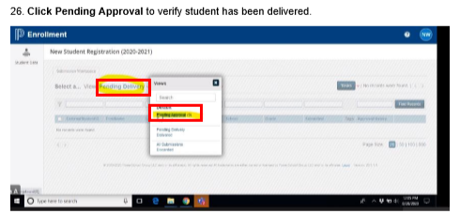
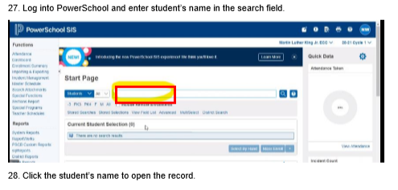
Delivery Steps 25-28

Slide 23
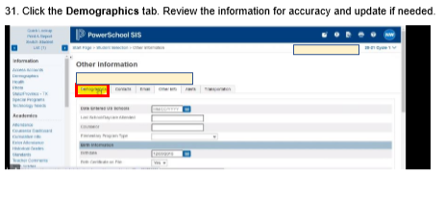
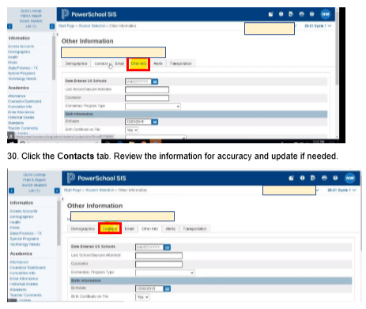
Delivery Steps 29-31

Slide 24
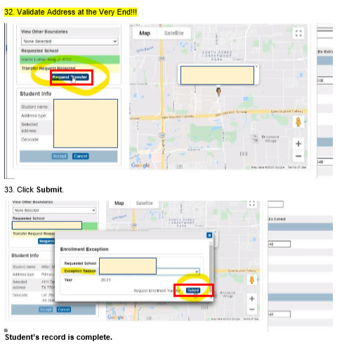
Delivery Steps 32 & 33

Slide 25
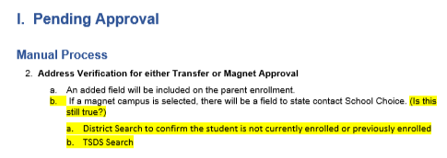
Pending Approval

Slide 26
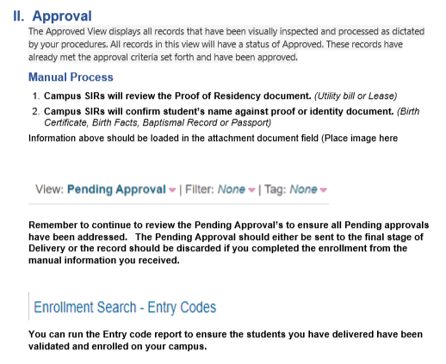
Approval

Slide 27
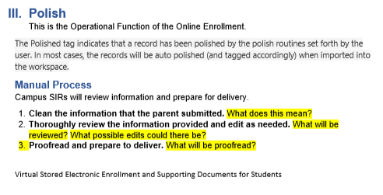
Polish

Slide 28
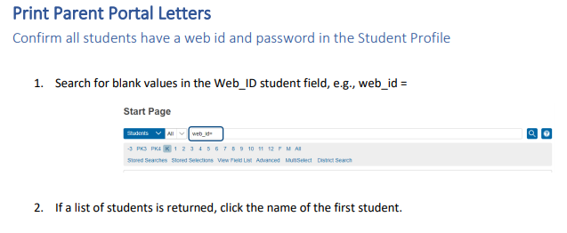
Print Portal Letters

Slide 29
Print Portal Letters

Slide 30
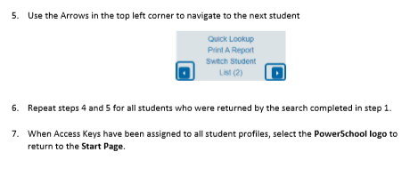
Print Portal Letters

Slide 31
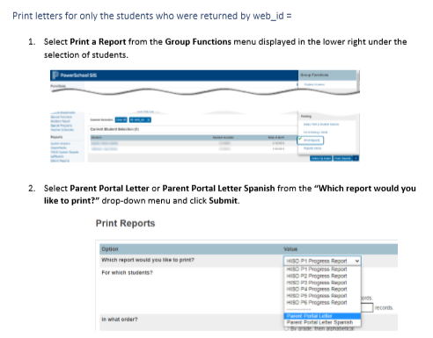
Print Portal Letters

Slide 32
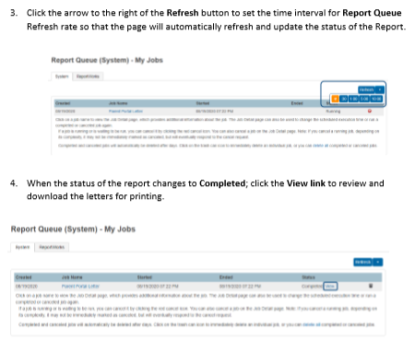
Print Portal Letters

Slide 33
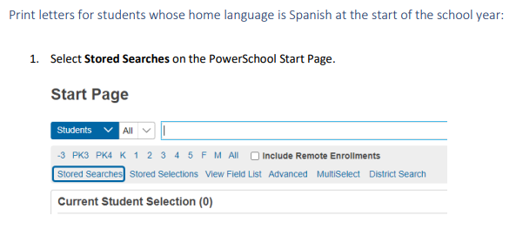
Printing Parent Portal Letters in Spanish

Slide 34
Printing Parent Portal Letters in Spanish

Slide 35
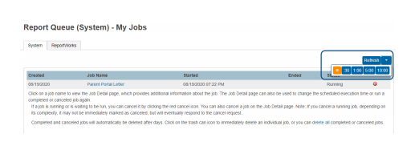
Printing Parent Portal Letters in Spanish

Slide 36
Printing Parent Portal Letters in Spanish

Slide 37
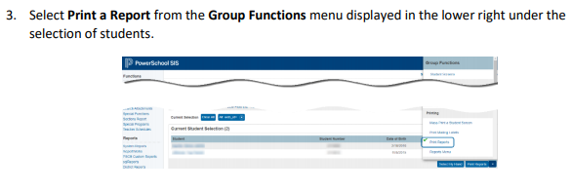
Printing Parent Portal Letters at Time of Enrollment
Print letters for students whose home language is not Spanish at the start of the school year:

Slide 38
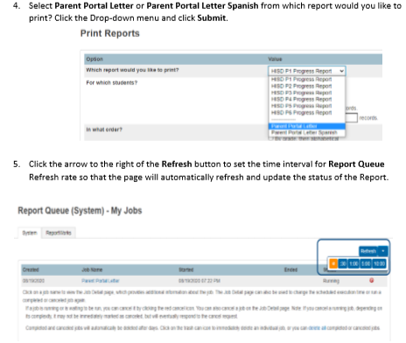
Printing Parent Portal Letters at Time of Enrollment

Slide 39
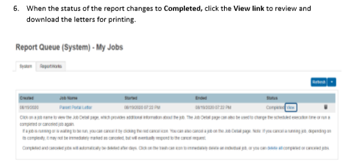
Printing Parent Portal Letters at Time of Enrollment

Slide 40
Printing Parent Portal Letters AFTER the start of school

Slide 41
Printing Parent Portal Letters AFTER the start of school

Slide 42
Printing Parent Portal Letters AFTER the start of school

Slide 43
Printing Parent Portal Letters AFTER the start of school

Slide 44
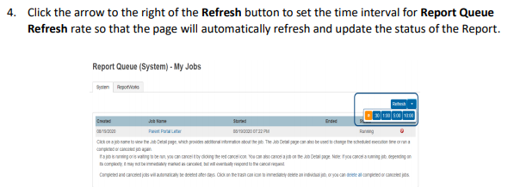
Printing Parent Portal Letters AFTER the start of school

Slide 45
Printing Parent Portal Letters AFTER the start of school

Slide 46
Printing Parent Portal Letters at Time of Enrollment

Slide 47
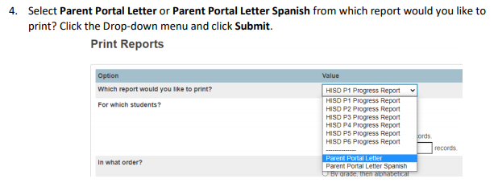
Printing Parent Portal Letters at Time of Enrollment

Slide 48
Printing Parent Portal Letters at Time of Enrollment

Slide 49
Printing Parent Portal Letters at Time of Enrollment

Slide 50
Federal and State Compliance Team
Name | Phone | Email
Roshunda Roberts-Jackson, Director | 713-556-6753 | Roshunda.RobertsJackson@houstonisd.org
Wanda Thomas, Sr. Manager | 713-556-6775 | wthomas1@houstonisd.org
Heidi Cisneros, Sr. Compliance Analyst | 713-556-6758 | Heidi.Cisneros@houstonisd.org
Sylvia Guerrero, Sr. Student Information Representative | 713-556-6773 | Sylvia.Guerrero@houstonisd.org
Lisa Shannon, Sr. Student Information Representative | 713-556-6766 | lshanno1@houstonisd.org
Sr. Student Information Representative, Vacant
Berta Garcia, Sr. Student Information Representative | 713-556-6753 | bgarcia3@houstonisd.org
Latonya Smith, Sr. Compliance Analyst | 713-556-7657 | lsmith3@houstonisd.org
Angela Tillmon, Sr. Student Information Representative | 713-556-6762 | atillmo1@houstonisd.org
Sr. Student Information Representative, Vacant
Tamika Whitmire, Sr. Student Information Representative | 713-556-6774 | twhitmir@houstonisd.org
Marina Tejada, Sr. Student Information Representative | 713-556-6753 | mtejada@houstonisd.org
Veda Winfree, Sr. Compliance Analyst | 713-556-6769 | vwinfree@houstonisd.org
Mildred Evans, Sr. Student Information Representative | 713-556-8813 | mevans7@houstonisd.org
Felicia Freeman, Sr. Student Information Representative | 713-556-6757 | ffreeman@houstonisd.org
Rosemary Fuentes, Sr. Student Information Representative | 713-556-6765 | rfuentes@houstonisd.org
Rachel Betancourt, Sr. Student Information Representative | 713-556-6753 | Rbentac2@houstonisd.org

Slide 51
State Reporting Team
Name | Phone | Email
Sr. Manager of State Reporting - Vacant
Irma Hasnain, Sr. Compliance Analyst | 713-556-6759 | ihasnain@houstonisd.org
Nancy Cintron, Sr. Compliance Analyst | 713-556-6767 | ncintron@houstonisd.org
Sr. Compliance Analyst- Vacant
Arian Sadri, Student Info and Report Analyst | 713-556-6753 | Arian.Sadri@houstonisd.org
Rosa Gamboa, Sr. Student Information Representative | 713-556-6753 | rgamboa@houstonisd.org

Slide 52
Thank you!
01/22/2021
Presenters:
Marina Tejada, Sr Student Information Rep

